Slide 1
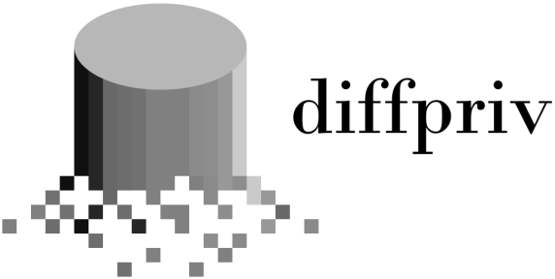

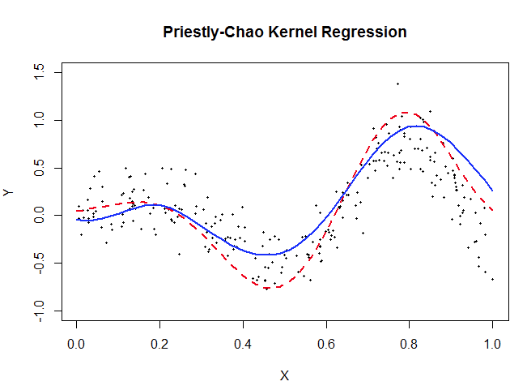
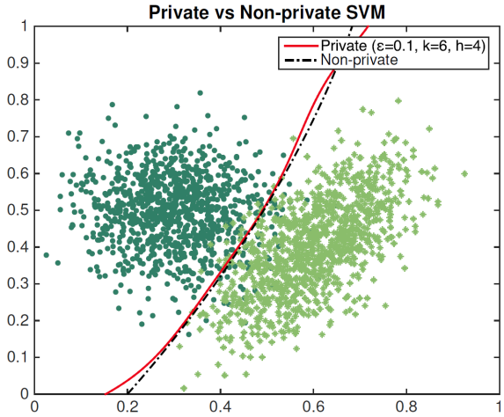

Provably-private learning in R
Formal guarantees Release aggregate info on dataset, protect privacy of individuals.
No more manual calculations
Advanced sampling theory
Users of Differential Privacy Apple, Google, Microsoft, US Census Bureau, Transport for NSW, …
https://brubinstein.github.io/diffpriv/

